Slide 1
ANZ Unconference 2018
20 – 21 November 2018
Marvel Stadium Melbourne

Slide 2

Microsoft Azure
Going Serverless
Simon Lamb

Slide 3

Session objectives and takeaways
Understand the evolution to “serverless” applications.
Recognize Azure platform support for different serverless architectures.
Have an awareness of code, scale, and management best practices.
Learn how to leverage “The DevOps” in an Azure serverless solution.

Slide 4
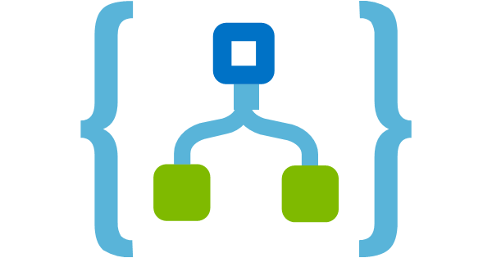



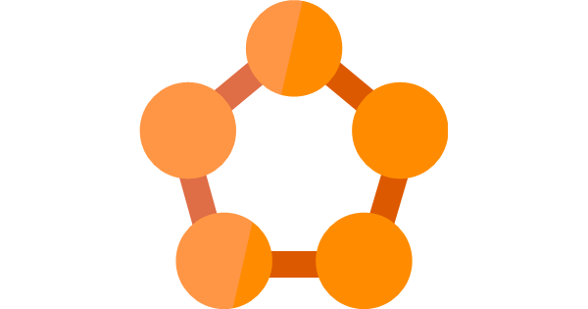
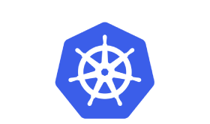
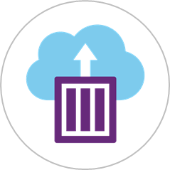


Application Progression
Business Apps
Microsoft Flow
PowerApps
Automation
Modernize
Logic Apps
Event Grid
Event Grid
Functions
Containerize
AppService
Service Fabric
Functions
ACI
AKS
Lift and Shift
IaaS VMs
Logic Apps

Slide 5
When should I consider serverless?
You need some action to occur whenever an event happens
This is a task I don’t need full control of the underlying system
Have some acceptance of latency variability

Slide 7
Serverless on Azure?
Execution Environments
Compute
Orchestration
Containers
Fully Managed Services
Messaging & Events
Database
Analytics
Intelligence

Slide 8
Serverless Compute
Azure Functions

Slide 9



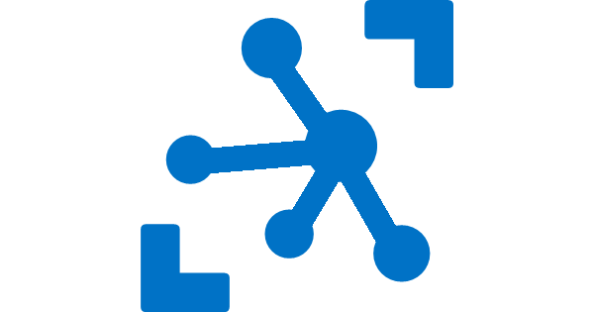
Ways to run functions on Azure
Consumption
Serverless
(Windows / Linux)
App Service Plan
Free, Basic, Standard, Premium
(Windows / Linux)
App Service Environment
Network Isolation
Azure Stack
On Premises
Azure Functions Runtime (GA)
Functions on your Server
Azure IoT Edge (GA)
On Devices
Pay only for what you use! Metering is per execution and per GB Second.
All the advantages of Functions with the SLA and ‘always on’ features of an App Service Plan.
Your own dedicated cloud environment with network isolation for apps, higher scale, and the ability to connect securely to local vNets.
Leverage cloud innovations in on-premises infrastructure. Azure Stack brings the power of Azure to your own data centers.
Run your Azure Functions on your local server (without the rest of Azure)
Run on IoT Devices by deploying custom modules.

Slide 10

Event Processing Architecture
Events need to be processed coming in from an event source.
Azure Functions processes each event (individually or in batches) and pushes to the event destination
Event Broker
Event Destination
Event / IoT Hubs
Service Bus Queue/Topic
Storage Queues
Event Grid
HTTP
CosmosDB, SQL, etc.
Event Source
Azure Function

Slide 11
Key Considerations
Each Event Source provides a different guarantee.
Ordered Processing – Azure Event Hubs
Guaranteed Processing – Queues / Topics
Very high throughput – Azure Event Hubs

Slide 12
Serverless API / Backend
Need to expose an endpoint that can return data to the client in the form of an API or application backend.
Azure API Management
Azure Function POST /routeA
Data Source
CosmosDB, SQL, etc.
Client
Azure Function
GET /routeA
Azure Function
POST /routeB

Slide 13
Key Considerations
API Management provides abstraction + a bunch of other niceties
Authentication
Policies / Traffic Routing
Monitoring
Versioning
Documentation
Proxies can act as “API-M light”, but for enterprise scenarios recommend API-M
Logic Apps and/or Durable can orchestrate complex processing

Slide 14
Rubbing a little DevOps on it…
Demonstration

Slide 15
Serverless Orchestration
Microsoft Flow
Logic Apps
Durable Functions

Slide 16
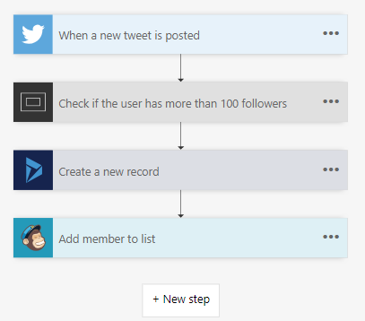
Flow & Logic Apps. The accessible options…
Designer-first integration services that enable the creation of workflows.
Connectors for integrating with external apps/services can be shared between Flow and Logic Apps.
Notes:
Grasping how orchestrators use execution history to replay and rebuild their local state is key to understanding how Durable Functions works, so let’s walk through the execution of a simple orchestrator function.
The light blue box at the top of the slide is the orchestrator’s code.
“SayHello” our activity function, which returns “Hello” and whatever input you give it.
Our execution history is currently empty. As we start to record events, they’ll show up here. (Indicate area.)
1. A request is made to the orchestrator function.
2. The orchestrator starts and begins executing until it’s asked to await some async work. In this case, we want to call an activity function.
3. The orchestrator checks the execution history for a record of the activity function.
4. There’s no record of the activity function being called or completed, so the orchestrator schedules that work.
5. While the orchestrator waits on work to complete, it shuts down.
5. The scheduled activity function runs.
6. A record of this is added to the execution history. In this case we produced output, so that’s stored.
7. Now the orchestrator has more work to do. It restarts and executes its code **from the beginning** to build up its local state.
8. As before, the orchestrator executes until it reaches an await.
9. The orchestrator checks the execution history. This time there’s a record of the async work being done.
10. The activity function’s stored output is passed back to the orchestrator. In this case, the value is added to a list of strings.
11. The orchestrator continues executing. In a more complex orchestrator with multiple await calls, the checkpoint, schedule and replay steps would repeat for each one. This orchestrator runs to completion and returns its output.
12. And we’re done!
- How does the framework know to wake up

Slide 17
Microsoft Logic Apps
Create, test and distribute from within the browser or from within Visual Studio/Visual Studio Code.
Supports DevOps activities (Versions control, testing, automation, etc)
Notes:
Grasping how orchestrators use execution history to replay and rebuild their local state is key to understanding how Durable Functions works, so let’s walk through the execution of a simple orchestrator function.
The light blue box at the top of the slide is the orchestrator’s code.
“SayHello” our activity function, which returns “Hello” and whatever input you give it.
Our execution history is currently empty. As we start to record events, they’ll show up here. (Indicate area.)
1. A request is made to the orchestrator function.
2. The orchestrator starts and begins executing until it’s asked to await some async work. In this case, we want to call an activity function.
3. The orchestrator checks the execution history for a record of the activity function.
4. There’s no record of the activity function being called or completed, so the orchestrator schedules that work.
5. While the orchestrator waits on work to complete, it shuts down.
5. The scheduled activity function runs.
6. A record of this is added to the execution history. In this case we produced output, so that’s stored.
7. Now the orchestrator has more work to do. It restarts and executes its code **from the beginning** to build up its local state.
8. As before, the orchestrator executes until it reaches an await.
9. The orchestrator checks the execution history. This time there’s a record of the async work being done.
10. The activity function’s stored output is passed back to the orchestrator. In this case, the value is added to a list of strings.
11. The orchestrator continues executing. In a more complex orchestrator with multiple await calls, the checkpoint, schedule and replay steps would repeat for each one. This orchestrator runs to completion and returns its output.
12. And we’re done!
- How does the framework know to wake up

Slide 18
Microsoft Flow
Flow is built on top of Microsoft Logic Apps.
Create, test and distribute from within the browser.
No DevOps support (Versions control, testing, automation, etc)
Notes:
Grasping how orchestrators use execution history to replay and rebuild their local state is key to understanding how Durable Functions works, so let’s walk through the execution of a simple orchestrator function.
The light blue box at the top of the slide is the orchestrator’s code.
“SayHello” our activity function, which returns “Hello” and whatever input you give it.
Our execution history is currently empty. As we start to record events, they’ll show up here. (Indicate area.)
1. A request is made to the orchestrator function.
2. The orchestrator starts and begins executing until it’s asked to await some async work. In this case, we want to call an activity function.
3. The orchestrator checks the execution history for a record of the activity function.
4. There’s no record of the activity function being called or completed, so the orchestrator schedules that work.
5. While the orchestrator waits on work to complete, it shuts down.
5. The scheduled activity function runs.
6. A record of this is added to the execution history. In this case we produced output, so that’s stored.
7. Now the orchestrator has more work to do. It restarts and executes its code **from the beginning** to build up its local state.
8. As before, the orchestrator executes until it reaches an await.
9. The orchestrator checks the execution history. This time there’s a record of the async work being done.
10. The activity function’s stored output is passed back to the orchestrator. In this case, the value is added to a list of strings.
11. The orchestrator continues executing. In a more complex orchestrator with multiple await calls, the checkpoint, schedule and replay steps would repeat for each one. This orchestrator runs to completion and returns its output.
12. And we’re done!
- How does the framework know to wake up

Slide 19
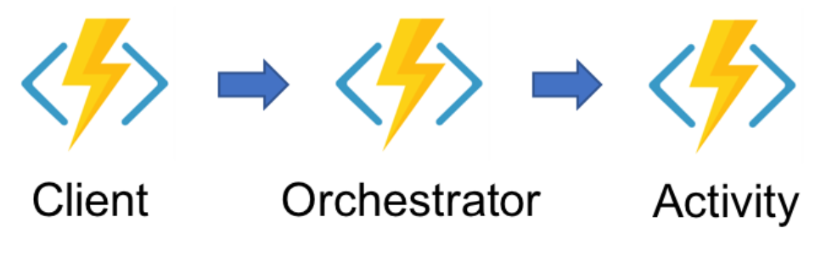
Durable Functions
Client Function – The triggered function that will create new instances of the orchestration.
Orchestrator Function – The heart of the function that describes which actions are execution and in what order.
Activity Function – The basic unit of work in a durable orchestration.
Notes:
Grasping how orchestrators use execution history to replay and rebuild their local state is key to understanding how Durable Functions works, so let’s walk through the execution of a simple orchestrator function.
The light blue box at the top of the slide is the orchestrator’s code.
“SayHello” our activity function, which returns “Hello” and whatever input you give it.
Our execution history is currently empty. As we start to record events, they’ll show up here. (Indicate area.)
1. A request is made to the orchestrator function.
2. The orchestrator starts and begins executing until it’s asked to await some async work. In this case, we want to call an activity function.
3. The orchestrator checks the execution history for a record of the activity function.
4. There’s no record of the activity function being called or completed, so the orchestrator schedules that work.
5. While the orchestrator waits on work to complete, it shuts down.
5. The scheduled activity function runs.
6. A record of this is added to the execution history. In this case we produced output, so that’s stored.
7. Now the orchestrator has more work to do. It restarts and executes its code **from the beginning** to build up its local state.
8. As before, the orchestrator executes until it reaches an await.
9. The orchestrator checks the execution history. This time there’s a record of the async work being done.
10. The activity function’s stored output is passed back to the orchestrator. In this case, the value is added to a list of strings.
11. The orchestrator continues executing. In a more complex orchestrator with multiple await calls, the checkpoint, schedule and replay steps would repeat for each one. This orchestrator runs to completion and returns its output.
12. And we’re done!
- How does the framework know to wake up

Slide 20
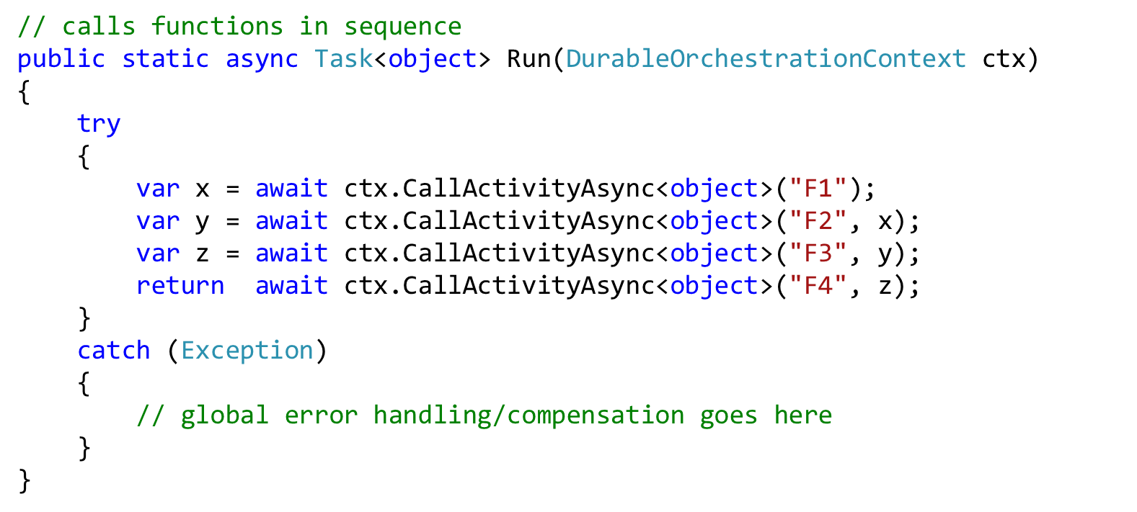





Solving practical problems…
Function chaining
Fan-out / fan-in
Event aggregation
Monitoring / scheduler
Human interaction / timeout
Async HTTP APIs
http
Notes:
KEY TAKEAWAYS:
* People are adopting Serverless rapidly across all providers and running into "cliffs". Durable Functions addresses many of these cliffs.
* Customers and partners are super-excited about Durable Functions (CSE hackfest demand, Subway & BMW are very interested, Oracle wants to collaborate, etc.)

Slide 21
Serverless Containers
Azure Container Instances
Kubernetes ACI Connector
Service Fabric Mesh

Slide 22
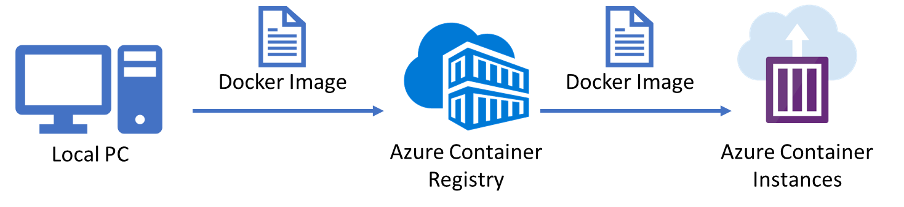
Azure Container Instances
Run containers without managing servers.
Increase agility with containers on demand.
Unlimited scale.
Billed for actual usage per second.
Useful for many different scenarios such as bursting or rarely executed adhoc operations.

Slide 23
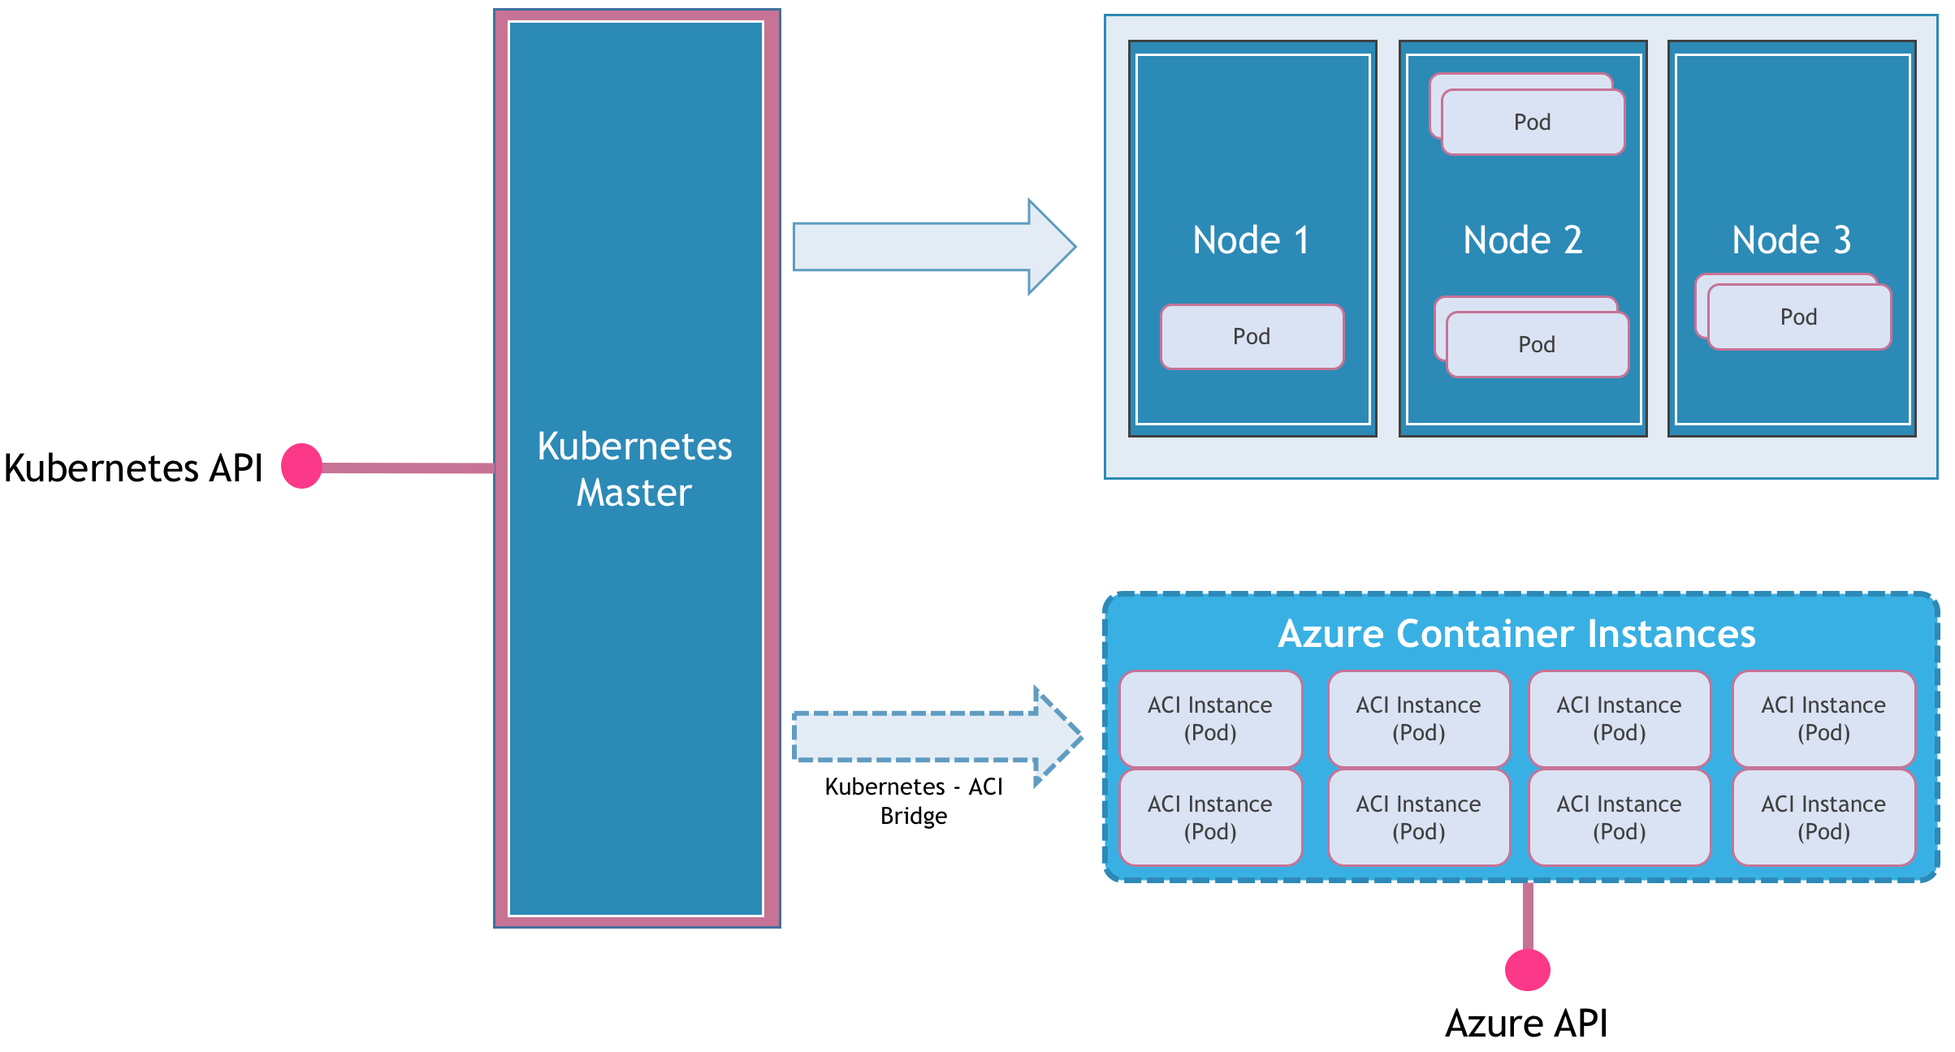
Kubernetes ACI Connector
A Virtual Kubelet implementation that allows provisioning of agents using Azure Container Instances.
Unlimited scale.
Billed for actual usage per second.
Useful for many different scenarios such as bursting or rarely executed adhoc operations.

Slide 24
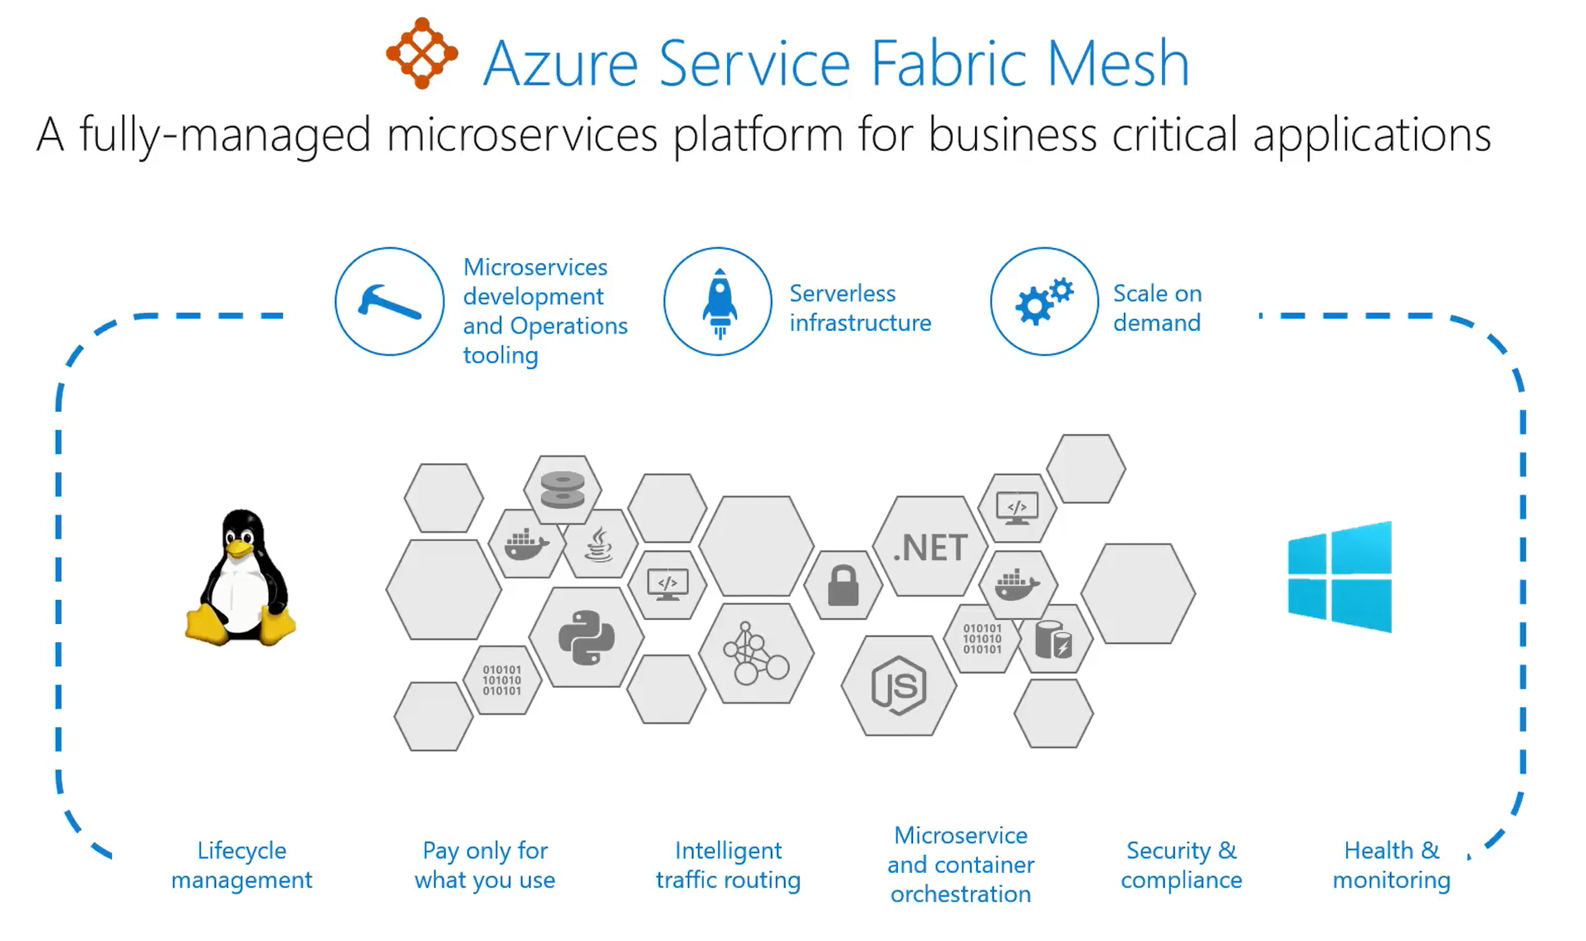
Service Fabric Mesh
Fully managed Azure Service Fabric
Enterprise-grade reliability, scalability, and mission-critical performance of Service Fabric for both Windows and Linux containers.

Slide 25
Serverless Messaging & Events
Event Grid
Event Hub
Service Bus

Slide 26
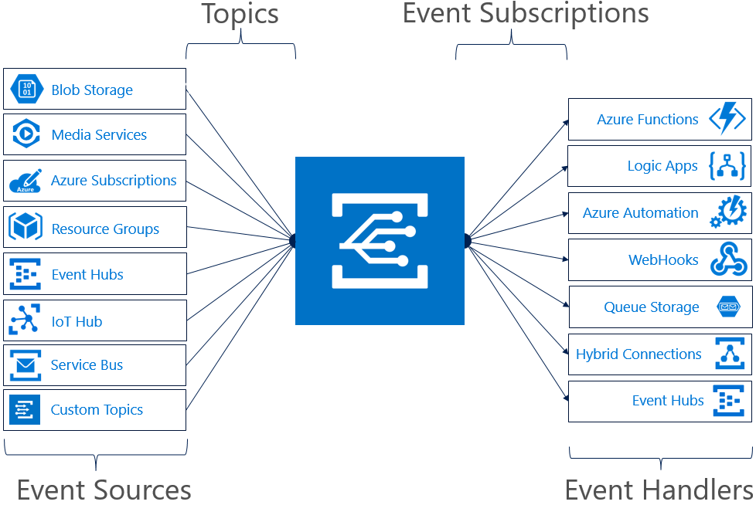
Event Grid
Serverless, dynamically scalable and low cost.
Exposes the events coming from the Azure platform.
Allows the creation of custom topics and webhooks for your own applications.
Use to create serverless app architectures, ops automation or app integration.

Slide 27

Event Hub
Low latency.
Capable of receiving and processing millions of events per second.
At least once delivery.

Slide 28
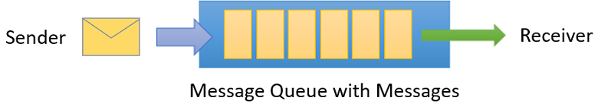
Service Bus
Reliable asynchronous message delivery (enterprise messaging as a service) that requires polling.
Advanced messaging features like FIFO, batching/sessions, transactions, dead-lettering, temporal control, routing and filtering, and duplicate detection.
At least once delivery.
Optional in-order delivery

Slide 29
Serverless Database Computing
Cosmos DB
Alternative Storage
Power Platform

Slide 30
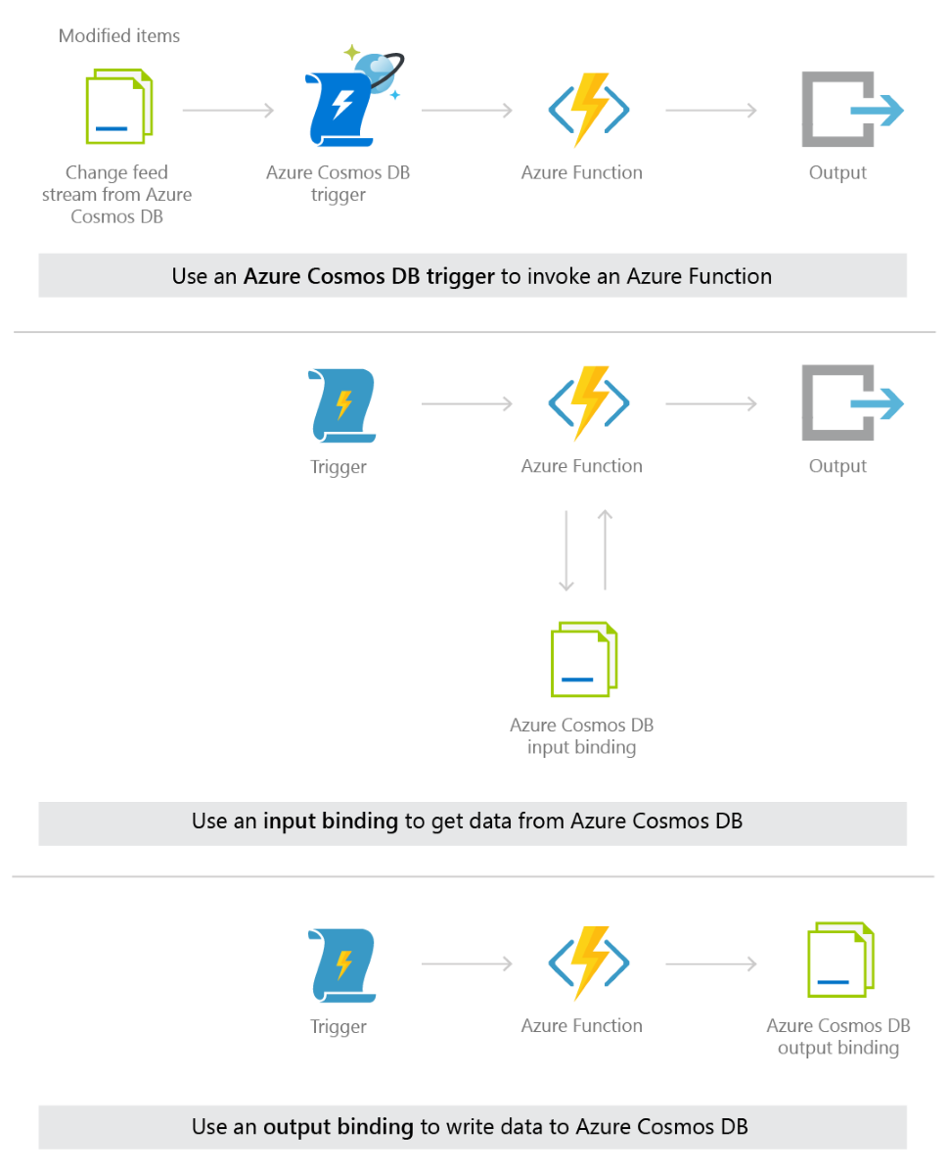
Cosmos DB and Azure Function Support
Trigger an Azure function from a Cosmos DB trigger and perform an action.
Retrieve data from Cosmos DB using an input binding.
Persisit data to Cosmos DB using an output binding.

Slide 31
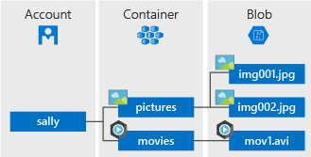
Blob Storage
If you don’t require deep indexing or are storing media files you may want to prioritise the use of blob storage.
Blob storage is optimized for storing massive amounts of unstructured data.
The Event Grid trigger will allow execution of Azure Functions on BlobCreated or BlobDeleted.

Slide 32
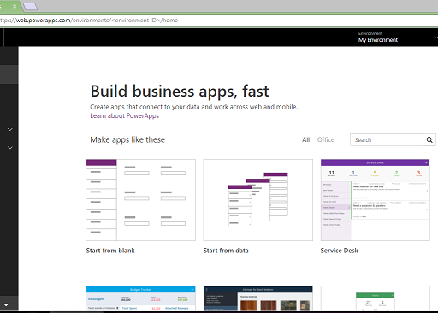
Power Apps
Quickly create apps that work on any device using a Microsoft Office-like experience a visual designer to automate workflows.
Use custom or built-in connections to connect PowerApps to cloud services such as Office 365 and Dynamics CRM and on-premises systems including SharePoint, SAP and more.

Slide 33
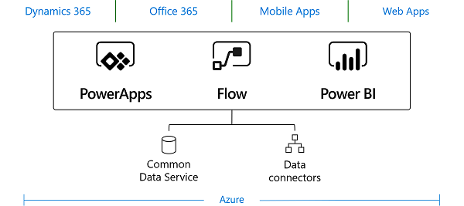
Common Data Service
Standard and custom entities within CDS for Apps provide a secure and cloud-based storage option for your data.
Natively access and combine with Dynamics 365 data.
Rich metadata, data types and relationships are leveraged by Power Apps.
Integrated Azure AD security to enable fine-grained role based security.

Slide 34
Power Platform
Demonstration

Slide 35
Wrapping up…
Compute
Orchestration
Containers
Messaging & Events
Database
Analytics
Intelligence

Slide 36
Further reading
Azure Functions – Significant Improvements in HTTP Trigger Scaling
https://www.azurefromthetrenches.com/azure-functions-significant-improvements-in-http-trigger-scaling/
Azure Serverless end-to-end with Functions, Logic Apps, and Event Grid:
https://azure.microsoft.com/en-us/resources/videos/azure-serverless-end-to-end-with-functions-logic-apps-and-event-grid/
The Case for Durable Workflows:
https://markheath.net/post/the-case-for-durable-workflows

Slide 37

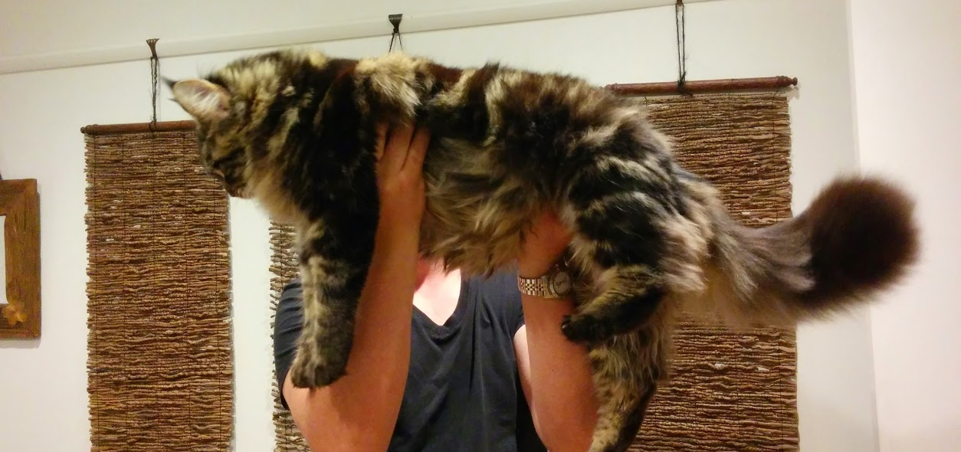
Thanks for listening!!!
Simon Lamb
Technical Evangelist
@slamb2k
https://simonlamb.codes

